Slide 1
Intro to Machine Learning
Tyler Tomita

Slide 2
What is machine learning?
The study, construction, or use of algorithms that can learn from and make predictions on data
Two broad categories of ML problems
Supervised learning: Given a set of example inputs and associated outputs, attempt to learn a function that maps inputs to outputs
Unsupervised learning: No outputs are given. The goal is to uncover structure in the inputs

Slide 3

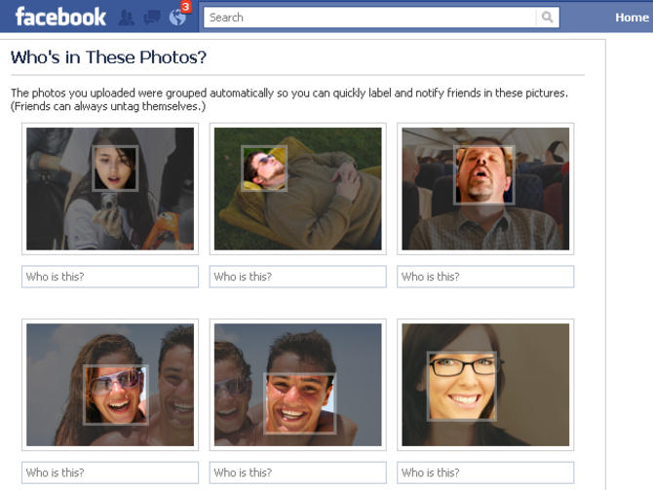
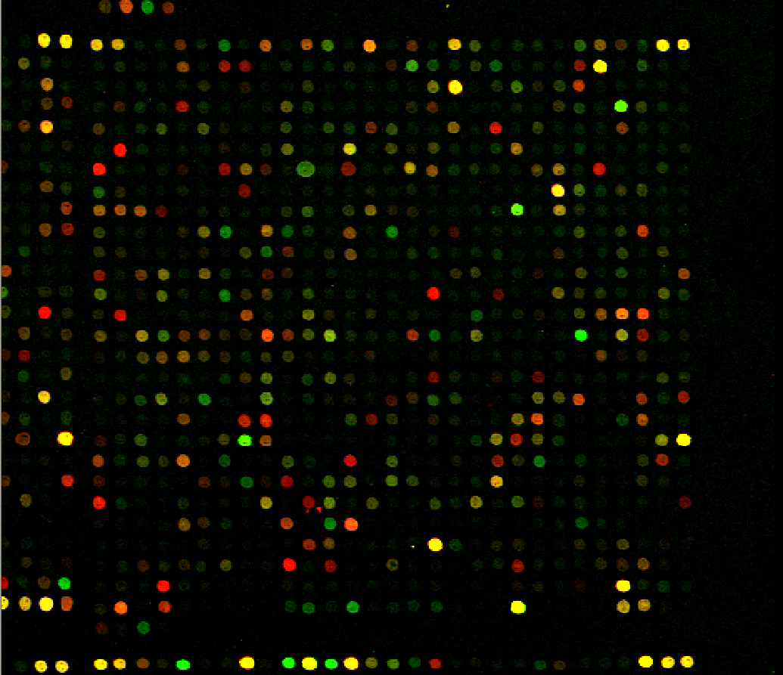
What is used for?
Face recognition
Spam detection
Predicting disease from microarray measurements

Slide 4
The supervised learning problem
Let X = (X₁,…,X_{p}) be a set of p input or predictor variables, also known as features, and Y be the output or response variable. Denote by x_{i} = (x_{i1},…,x_{ip}) the input for the ith training example and let y_{i} be the output for the ith training example. Suppose we have n training examples (x₁,y₁),…,(x_{n},y_{n}).
GOAL: find a function f: X → Y

Slide 5
The supervised learning problem
When Y is continuous, the task is called regression
Ex: predicting housing prices, life span, tomorrow’s temperature
When Y is discrete/categorical, the task is called classification
Ex: predicting if someone has a disease, spam detection, image object detection

Slide 6
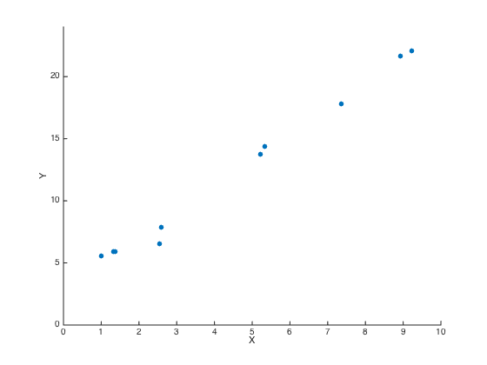
Example: linear regression

Slide 7
Example: linear regression
Y = β_{o} + β₁X

Slide 8
Example: linear regression
Ŷ = f_{β}(X) = β_{o} + β₁X
f_{β} (X_{i}) – Y_{i}
How do we find β_{o} and β₁?
(β_{o},β₁) = argmin J(β) = Σ(f_{β} (X_{i}) – Y_{i})²

Slide 9
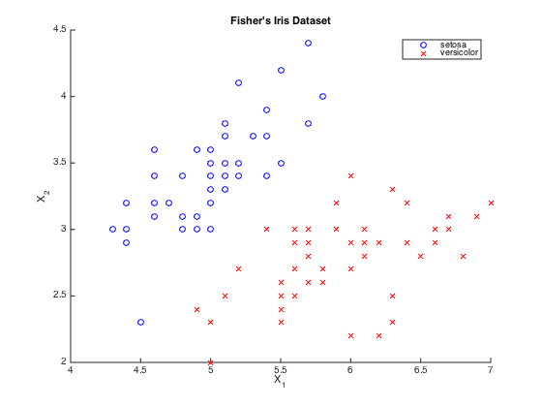
Example: classification
X₁: sepal length
X₂: sepal width
Y: flower type
Find a classifier function f(X) that predicts flower type from sepal length and sepal width

Slide 10
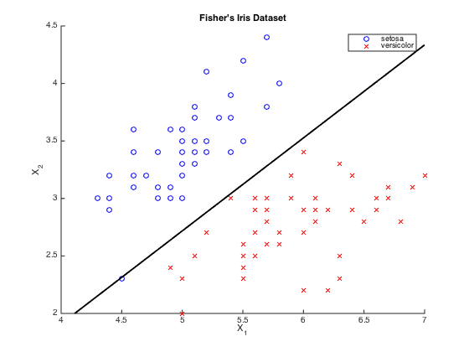
Example: classification
X₁: sepal length
X₂: sepal width
Y: flower type
Find a classifier function f(X) that predicts flower type from sepal length and sepal width
Linear decision boundary
LDA: f(X) = I[log(P(setosa|X; θ)/P(versicolor|X;θ)) < 0], where log(P(setosa|X; θ)/P(versicolor|X;θ)) is linear in X.
Decision boundary: the set of possible values of X s.t. log(P(setosa|X; θ)/P(versicolor|X;θ)) = 0

Slide 11
Example: classification
X₁: sepal length
X₂: sepal width
Y: flower type
Find a classifier function f(X) that predicts flower type from sepal length and sepal width
Nonlinear decision boundary
QDA: f(X) = I[log(P(setosa|X; θ)/P(versicolor|X;θ)) < 0], where log(P(setosa|X; θ)/P(versicolor|X;θ)) is quadratic in X

Slide 12
Overview of classification algorithms
Linear (produces linear decision boundary)
Linear discriminant analysis (LDA), logistic regression, linear support vector machine (SVM)
Nonlinear
Quadratic discriminant analysis (QDA), k-nearest neighbors (k-NN), nonlinear SVM, neural networks, classification trees, random forests

Slide 13
Decision tree

Slide 14
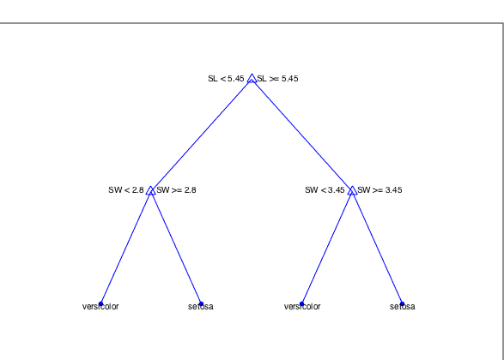
Classification tree

Slide 15
Classification tree

Slide 16
Classification tree

Slide 17
Classification tree

Slide 18
Classification tree
R4
R2
R3
R1
R1
R2
R3
R4

Slide 19
Classification tree
R4
R2
R3
R1
R1
R2
R3
R4
Split directions and values are typically determined by minimizing some measure of heterogeneity or impurity
The most common measure is the gini impurity: Σ_{k}p_{mk}(1 – p_{mk})
where p_{mk} is the fraction of points at node m belonging to class k

Slide 20
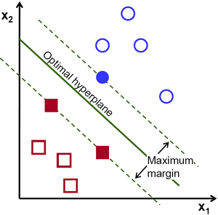
Support vector machine
Rather than modeling probability distributions, SVM computes distances to find the maximum margin hyperplane

